Slide 1
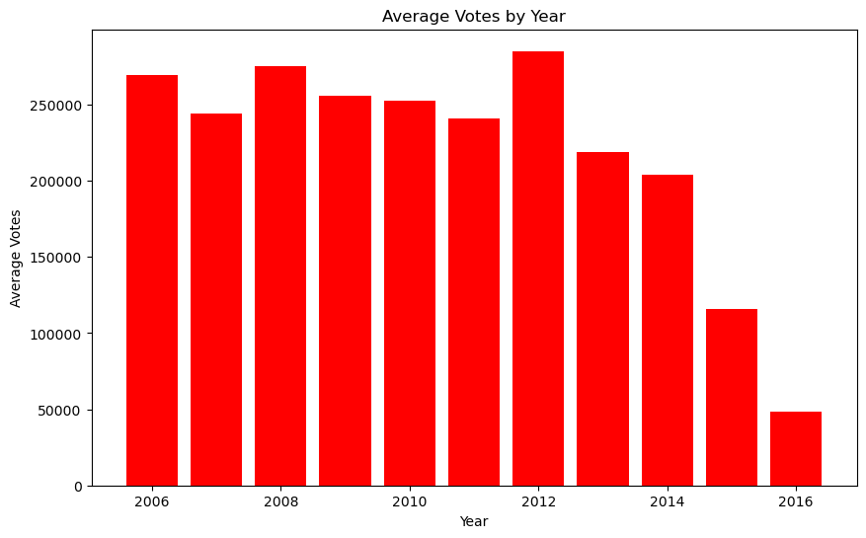
show variation btw year had the highest average voting

Slide 2
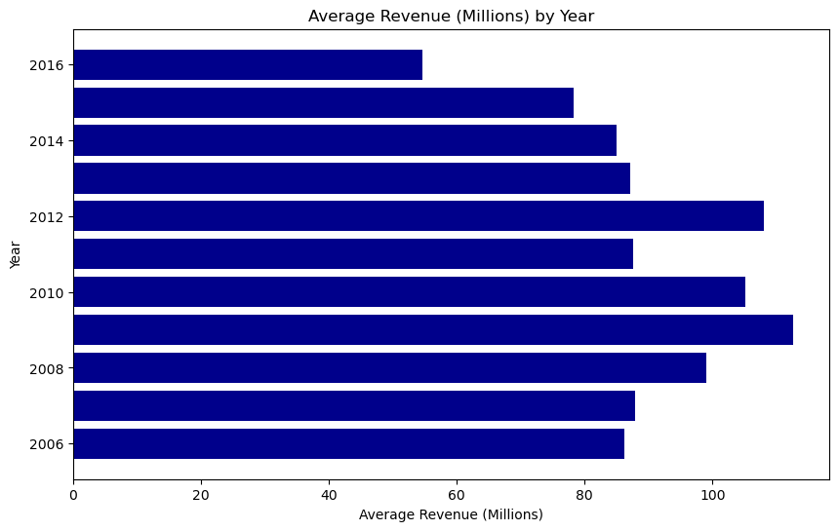
Which year had the highest average revenue

Slide 3
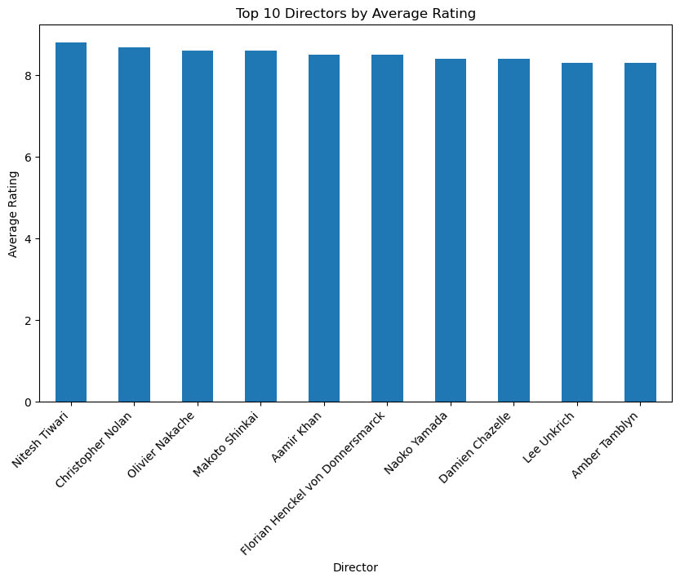
Average rating for top 10 directors

Slide 4
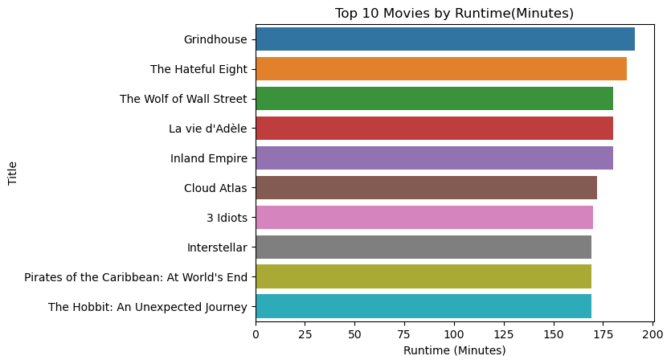
Top 10 lengthy movies and runtime

Slide 5
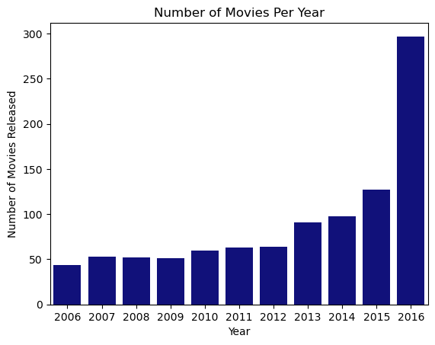
How many movies were watched in each year

Slide 6
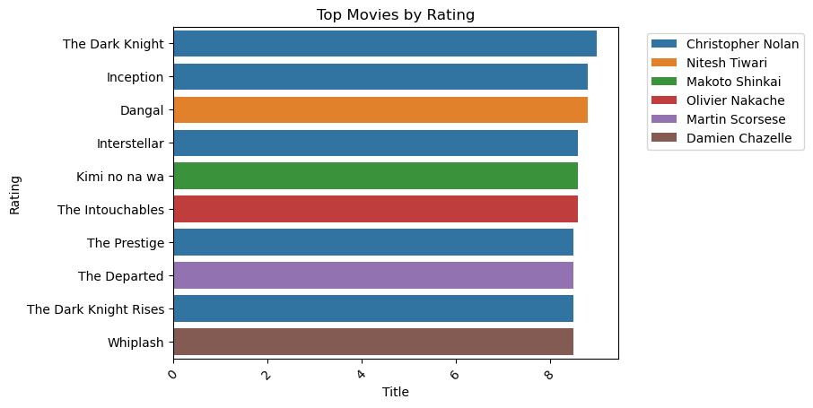
Top 10 highest rated movie titles and its directors

Slide 7
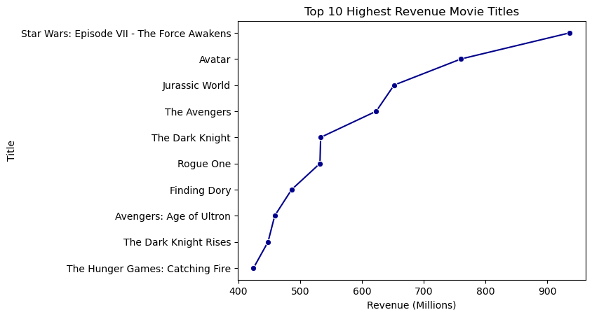
Top 10 highest revenue movie titles

Slide 8
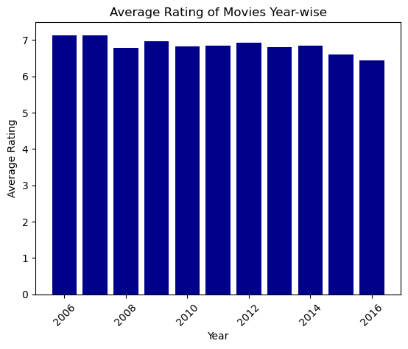
Average rating of movies Year wise

Slide 9
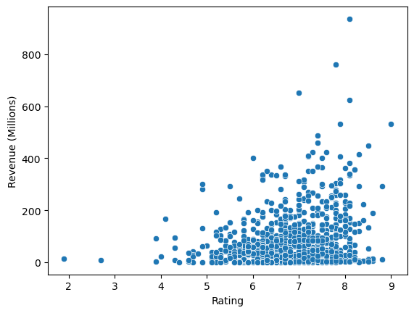
Does rating affect revenue

